Slide 1
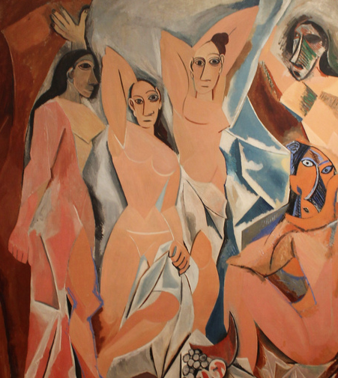
Art Appreciation Week 1 — The Visual World
ARTS 1301 Art Appreciation

Slide 2
Art Appreciation Instructor: Professor James S. Cost, MFA Art Cel Phone: (806) 206-0099 Email: jscost@actx.edu Personal web site: www.stevencost.com

Slide 3
Question: What do you wish to achieve in Art Appreciation? Two questions that are often asked comes from just about everyone, and especially educational institutions such as this one: What is Art? What is it good for?

Slide 4
Question: What do you wish to achieve in Art Appreciation? How will you use your new knowledge in the future?

Slide 5
What problems can we try to solve in the course? We won’t be making art in the class, but we will learn how art is made. We will use our textbook, other books, the instructor’s lectures and our shared art experiences. Also we will view many videos. We will look at art in the Amarillo Museum of Art, which is on campus.

Slide 6
What problems can we try to solve in the course? What would we do? What if ART was damaged, such as the incident when a person knocked off part of Michaelangelo’s Pieta statue with a hammer? Or partially destroyed, such as the recent fire in the Notre Dame Cathedral in Paris, France? What if ART was being stollen, such as by the Nazis in World War II?

Slide 7
Many of us in the class have seen art in special places. You may come from another city or country, or have traveled. Would you be willing to share what art, monuments, architecture, and more — that your have seen from your own experience? Do you have photos or videos? What other learning methods should we use in our class?

Slide 8
Take A look at Our Visual World.

Slide 9
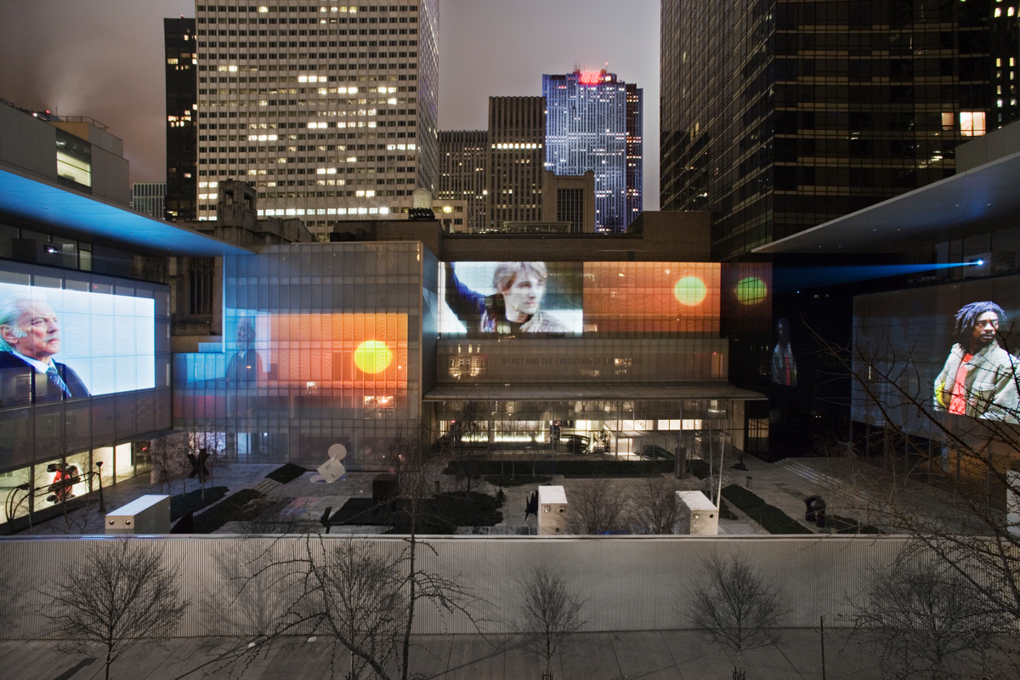
Click on image for video
Doug Aitkens, Sleepwalkers, Museum of Modern Art 2007 New York City

Slide 10
Question: What is the purpose of Doug Aitken’s installation Sleepwalkers? Why is it being projected on the outside walls of the New York Museum of Modern Art ? From where does the money come? Why would big money be spent on this?

Slide 11
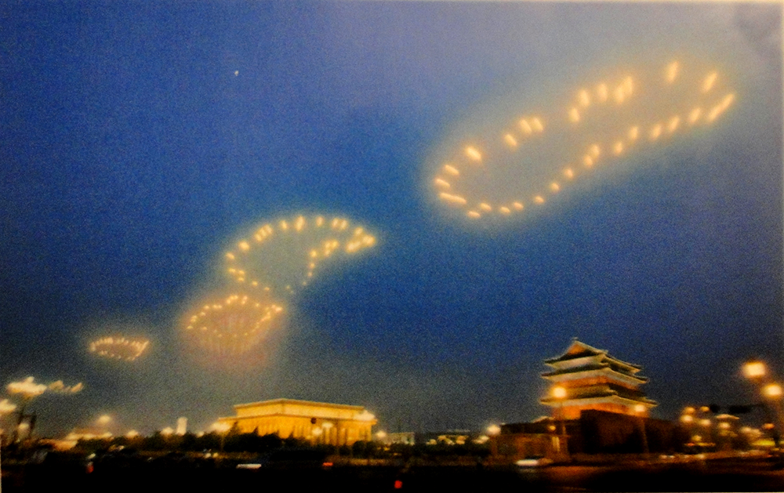
Click on image for Video
Cai Guo-Qiang, Footprints of History: Fireworks Project for the Opening Ceremony of the 2008 Beijing Olympic Games

Slide 12
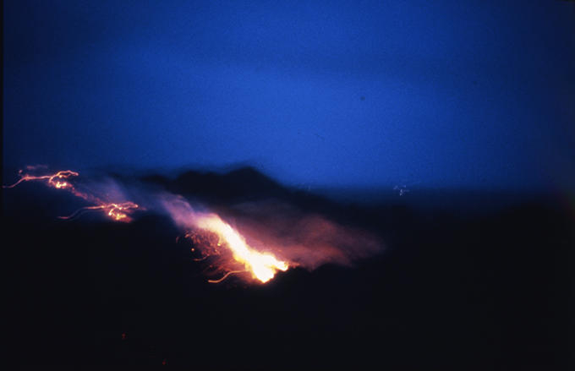
Click on image for video
Cai Guo-Qiang, Project to extend the Great Wall of China
Gobi Desert, February 27, 1993

Slide 13
How we see and process art.

Slide 14
In the process of seeing art, the act is not just a direct recording of the reality. Seeing is both a physical and psychological process. Physically, visual processing can be divided into three steps. They are: reception —> extraction —> inference

Slide 15
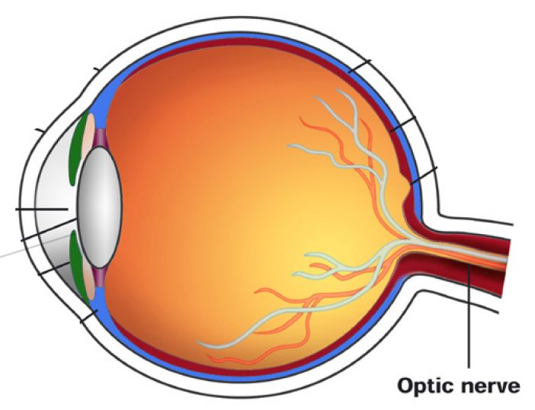
RECEPTON: light enters the eye — seeing with nervous system. EXTRACTION: sensors in the retina edit the light. INFERENCE: visual cortex processes the information the retina sends it.

Slide 16
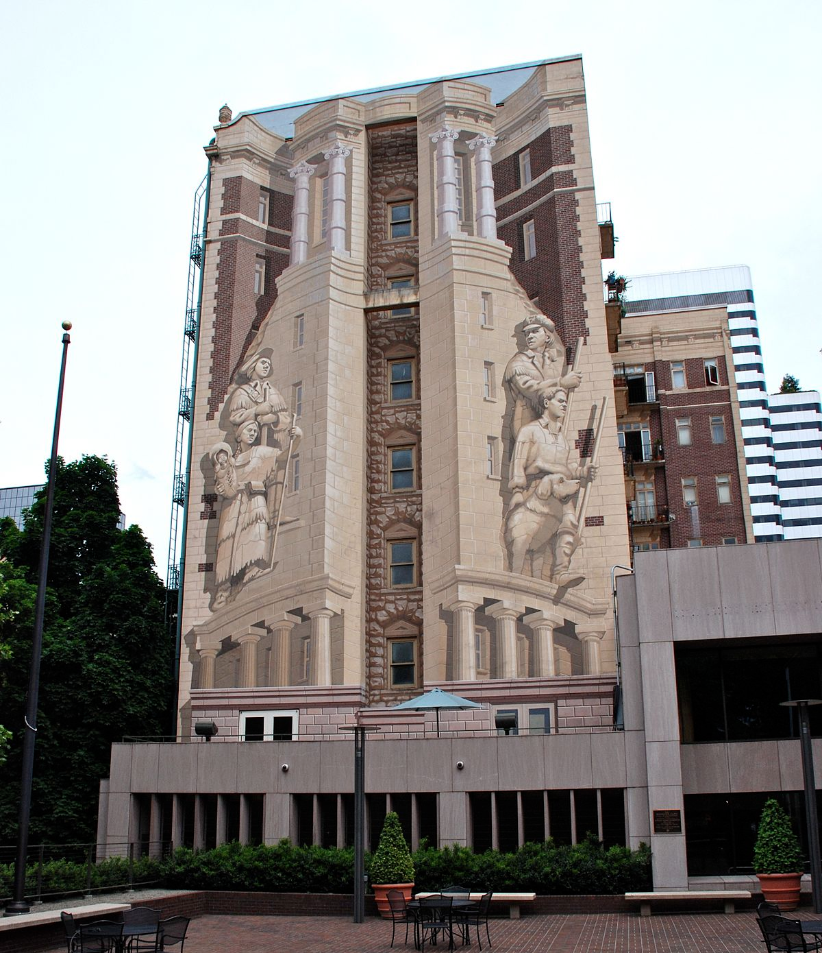
Richard Hass
Trompe-l’oeil illusion painting on the exterior of the Oregon Historical Society Headquarters.
In this case, the purpose is to recreate the architecture by painting and illusion on the building, without rebuiilding or modifying the structure.

Slide 17
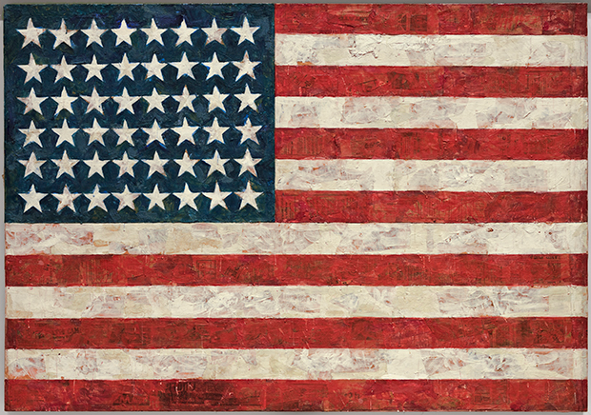
Using “active seeing ” Jasper Johns uses the image of the American Flag to see in a new way, filtering our perception through history, fears, prejudices, emotions, and beliefs.

Slide 18
The Elements of Design are with what we design and make art:
Shape Tonal Value Line Texture Color

Slide 19
Composition is another word for Design. Composition is accomplished by applying the Principles of Design:
Emphasis
Contrast
Balance
Directon
Variety
Rhythm
Movement
Harmony

Slide 20
All people are or can be creative, but not all people possess the energy, ingenuity, and courage of conviction that are required to make art.

Slide 21
While differing from culture to culture and from time to time, the term, “Aesthetic,” refers to our sense of the beautiful.

Slide 22
The art term “CONTENT” is used to define what a work of art expresses or means (or suggests to the viewer’s imagination).

Slide 23
When we speak of the “FORM” of a work of art, we mean everything from the materials used to make it, to the way it employs the various formal elements , to the principles — the ways in which those elements are organized into a composition. It is the overall structure of a work of art.

Slide 24
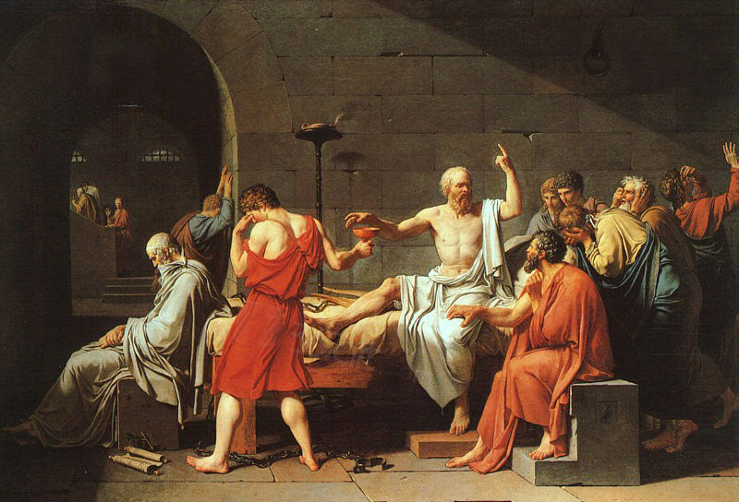
Discuss the Form and Content of Jacques Louis David’s The Death of Socrates, 1787
Click on image for video
Discu

Slide 25
Iconography or “ICON” is the term used when cultural conventions are often carried forward from one generation to the next by means of a system of visual images the meaning of which is widely understood by a given culture?

Slide 26
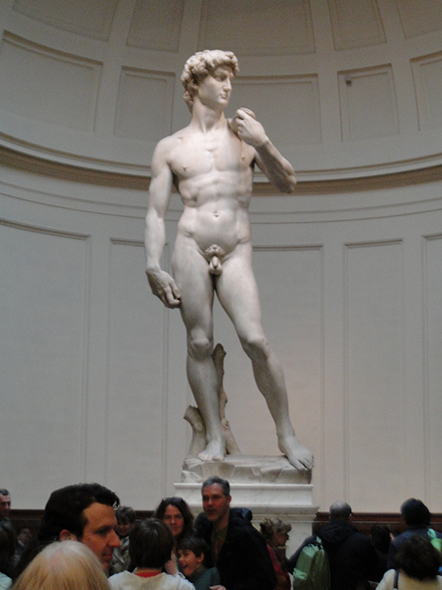
An ICON of Western European art: David by Michaelangelo Buonarroti, marble, Florence 1504. My students literally wept with emotion when they approached. Why would they do that?
Photo by
Steven Cost
Florence, Italy
2015

Slide 27
FORM: What are the art arrangements, techniques, and size and other elements and priciples in David? For instance why are the hands larger than normal?

Slide 28
CONTENT: What is the story, meaning and message David? Where is Goliath? Why is David nude?
Click on image for video

Slide 29
Most artists think of themselves as assuming one of four fundamental roles—or some combination of the four—as they approach their work. Those four roles are: 1. Artists create a visual record of their time and place.

Slide 30
2. Artists help us to see the world in new and innovative ways.

Slide 31
3. Artists make functional objects and structures more pleasurable by instilling them with beauty and meaning.

Slide 32
4. Artists give form to non-material ideas and feelings

Slide 33
Should art be made to SELL, or is it alright to make art for the need or pleasure of doing so, even if it never commissioned or sells?

Slide 34
How is the value and price of art determined? Among other ways, the relative rarity of a work of art on the art market, the economy, and the participation of of wealthy clients through their investment, ownesrhip, and patronage.

Slide 35
How is the value and price of art determined? Also art showing in prestigious art galleries, art museums, and art auction houses. Sometimes it is simply determined by how much a buyer wants the art or how much or little the seller wants to price it.

Slide 36
How is the value and price of art determined? Sometimes art is made for other reasons than to be sold. If making the art is expensive, then patron may donate through grants to help artists create the art.

Slide 37
Generally, we refer to works of art as either REPRESENTATIONAL (such as realism) or ABSTRACT.

Slide 38
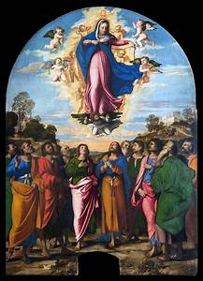
REPRESENTATIONAL art: Assumption of the Virgin by Titian

Slide 39
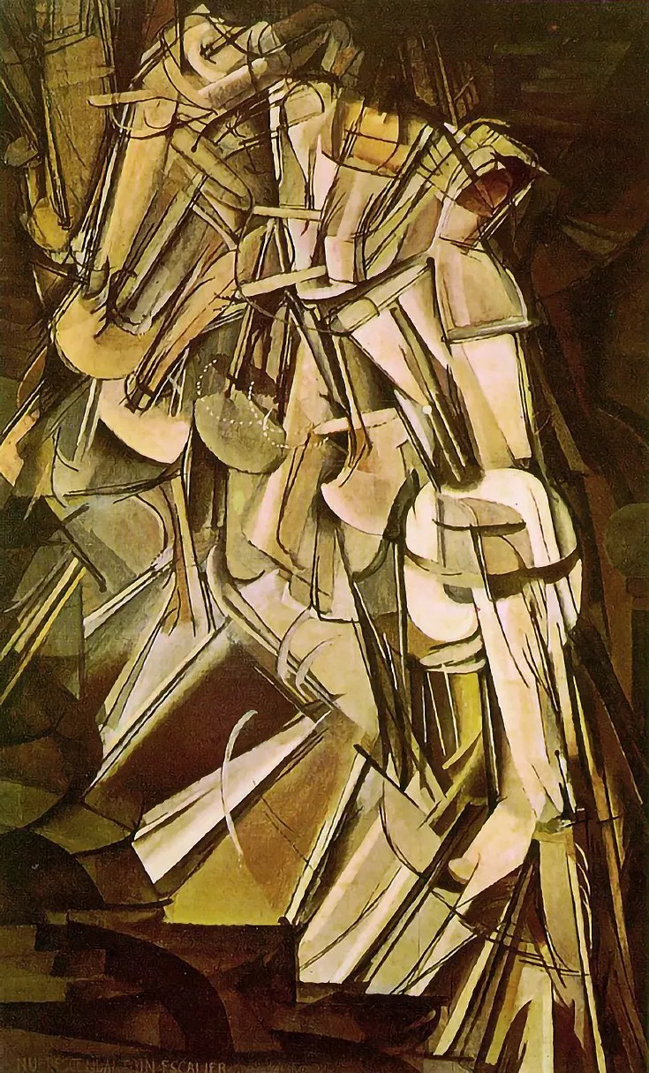
ABSTRACT art: Nude Descending a Staircase by Marcell Dechamp

Slide 40
The Process of Seeing From Hyper-realistic Naturalism to Nonobjective Abstrations

Slide 41
El Lizitski, Beat the Whites with the Red Wedge, Russia 1919,

Slide 42
Hyper Reality Art

Slide 43
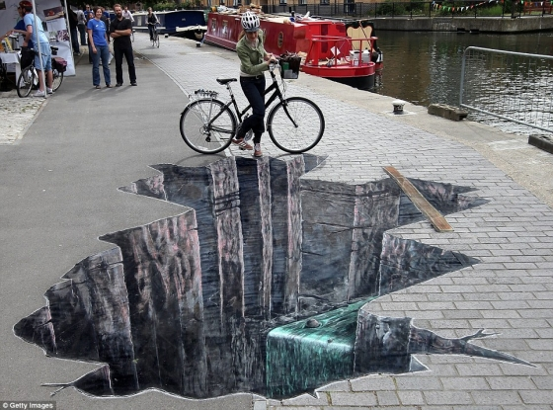
Click on image for Video
Sidewalk Trompe l’oeil by Edmund Mueller

Slide 44
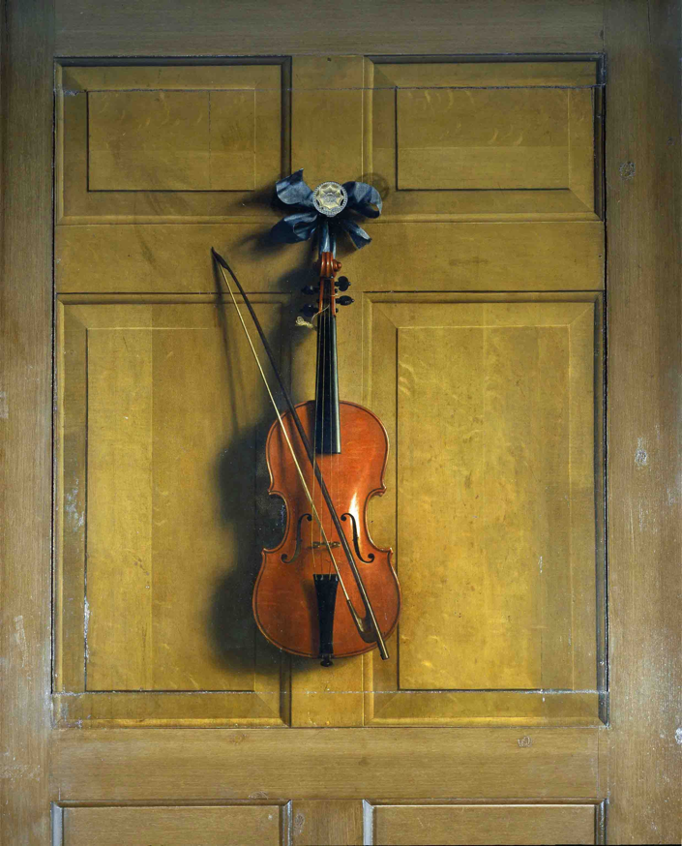
Tompe l’oeil by Chatsworth House, Violin, oil on panel

Slide 45
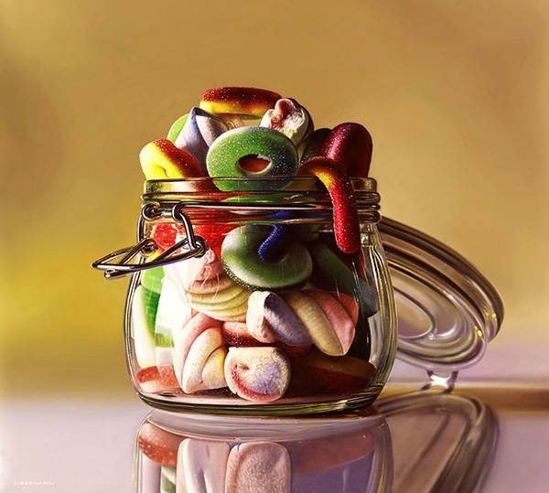
Tompe l’oeil

Slide 46
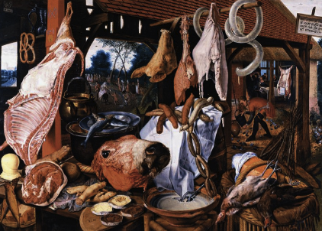
Peter Aertsen, Butcher’s Stall with the Flight into Egypt Oil on wood panel, 1551

Slide 47
Representation Art

Slide 48
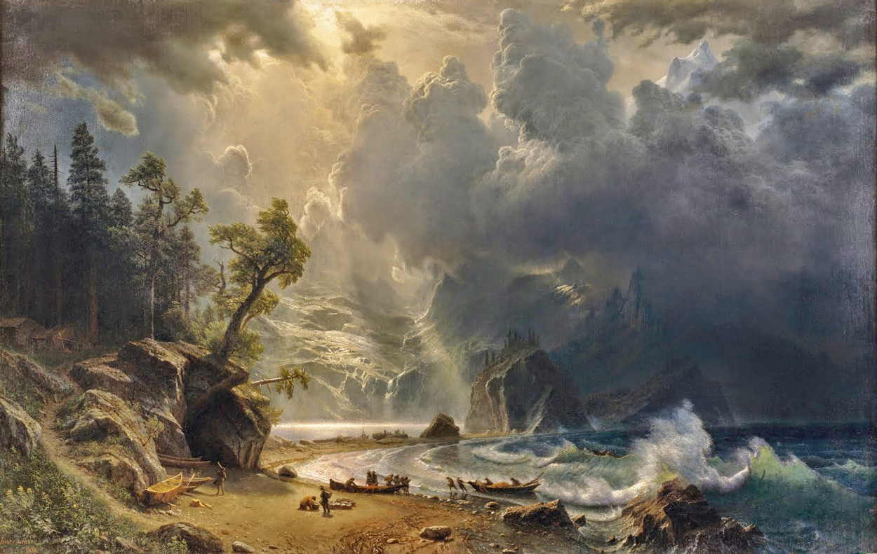
Albert Bierstadt, Puget Sound on the Pacific Coast, 1870 6’ x 4’

Slide 49
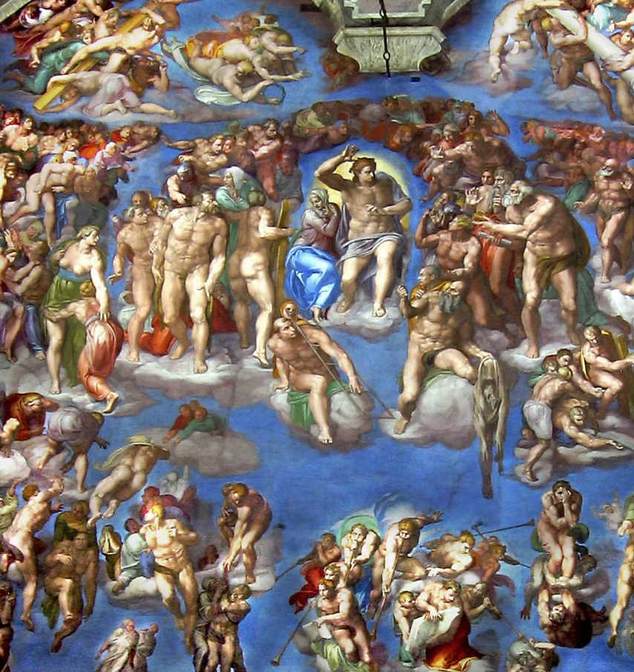
Michaelangelo, Sistine Chapel Alter Wall

Slide 50
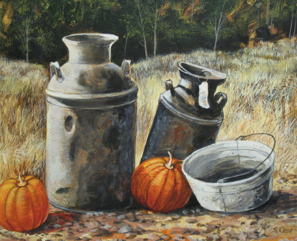
Steven Cost, Milk Cans and Pumpkins, collection of Dr. Pablo Diaz, acrlics on panel

Slide 51
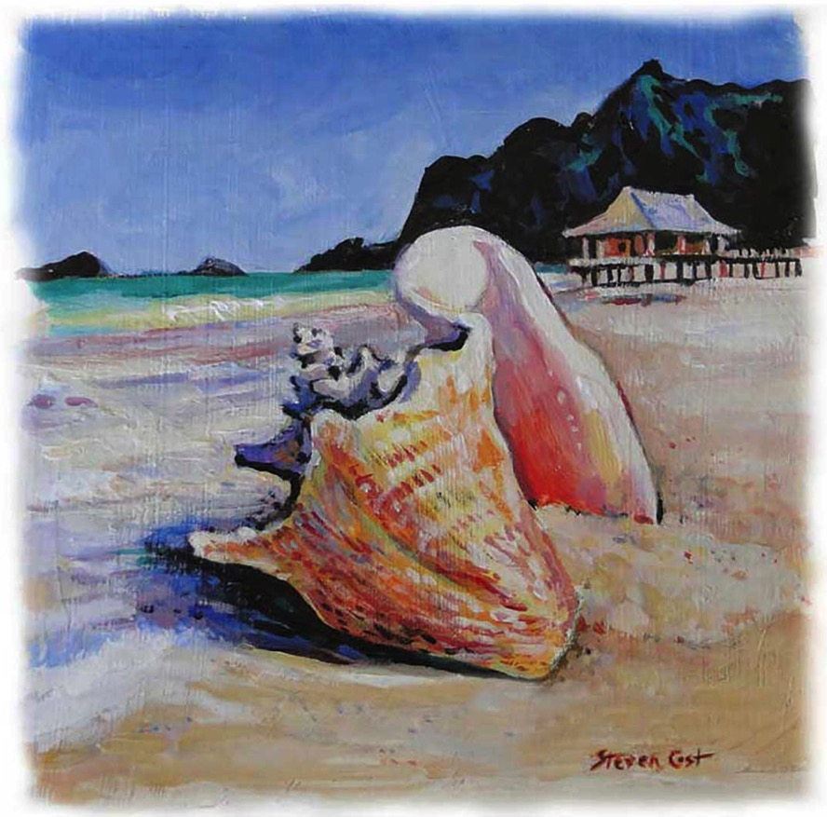
Steven Cost, Conch on the Beach, acrylics on paper 2014

Slide 52
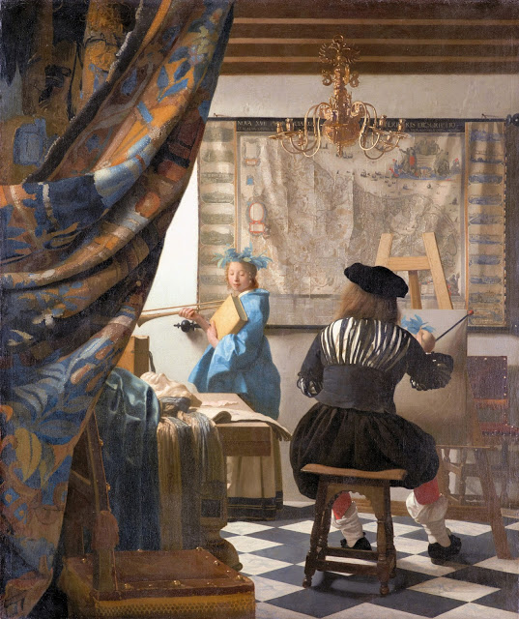
Johannes Vermeer, The Art of Painting, Oil on canvas, Dutch 1665

Slide 53
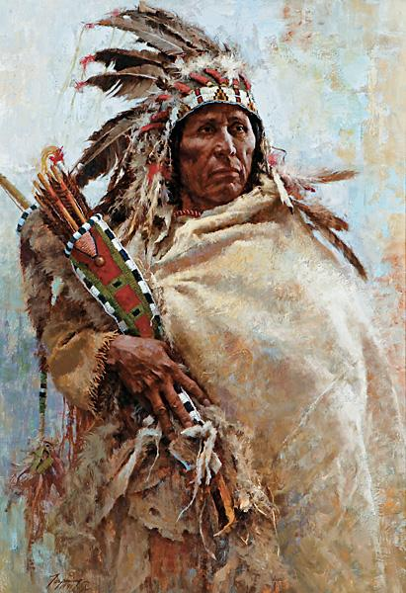
Howard Terpning, Leader of Menby, oil 1977

Slide 54
Surrealism Art

Slide 55
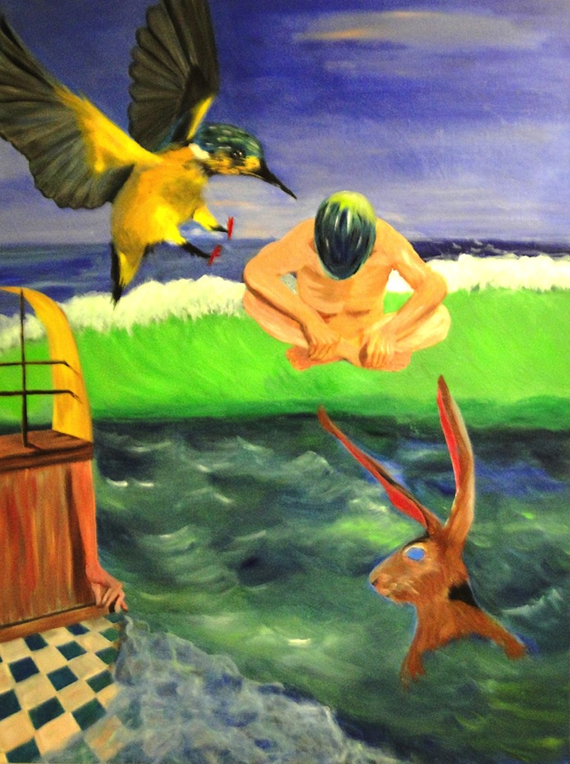
Marsha Shrader, The Dream, acrylics on canvas, Amarillo 2015

Slide 56
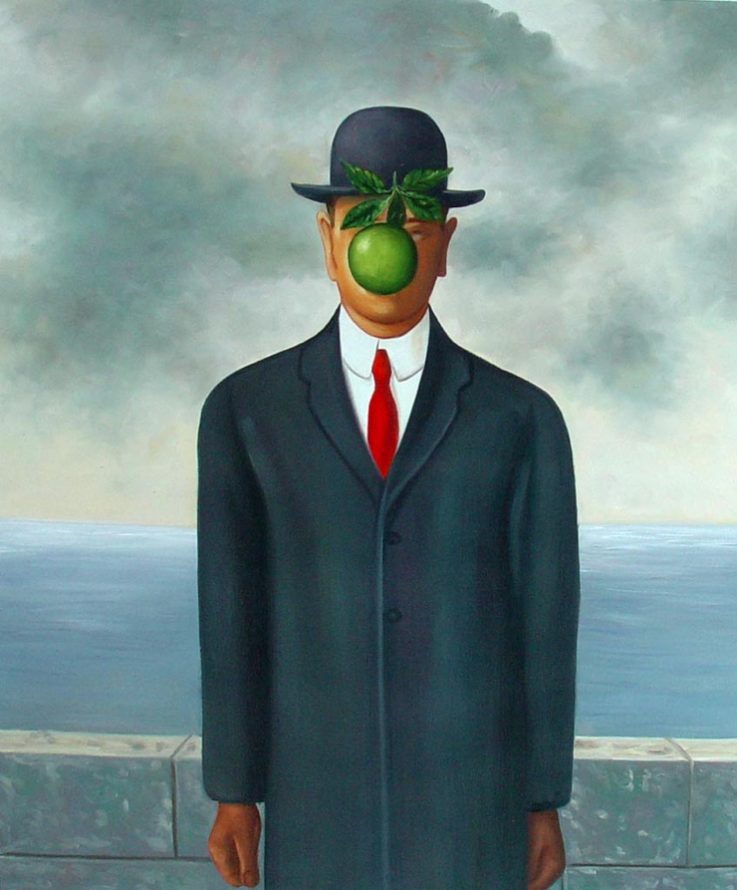
Click on image for Video
Rene Magritte, The Son of Man, oil on canvas, Belgium 1940

Slide 57
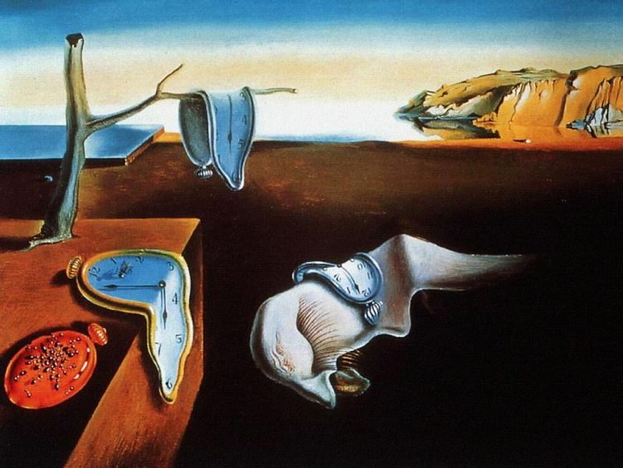
Click on image for Video
Salvador Dali, The Persistance of Memory, oil on canvas,
Spain 1931

Slide 58
Impressionistic Art

Slide 59
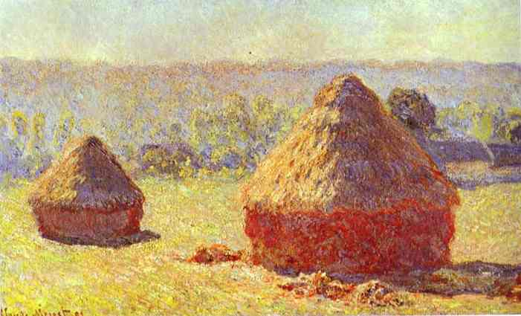
Click on image for Video
Claude Monet, Haystacks — End of the Summer Morning, 1891

Slide 60
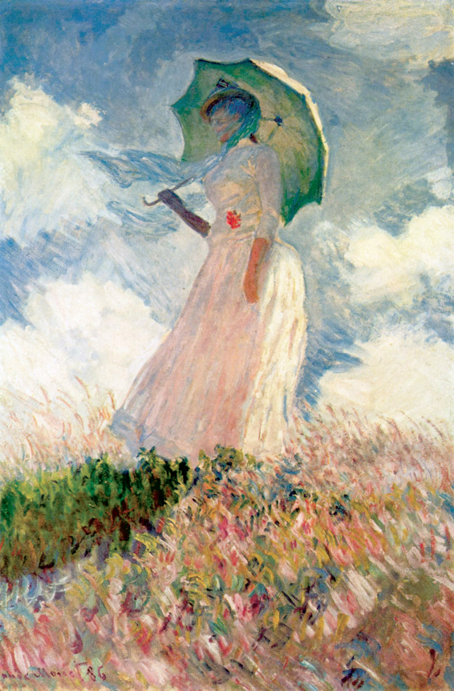
Click on image for Video
Claude Monet, Woman with a Parasol, 1926

Slide 61
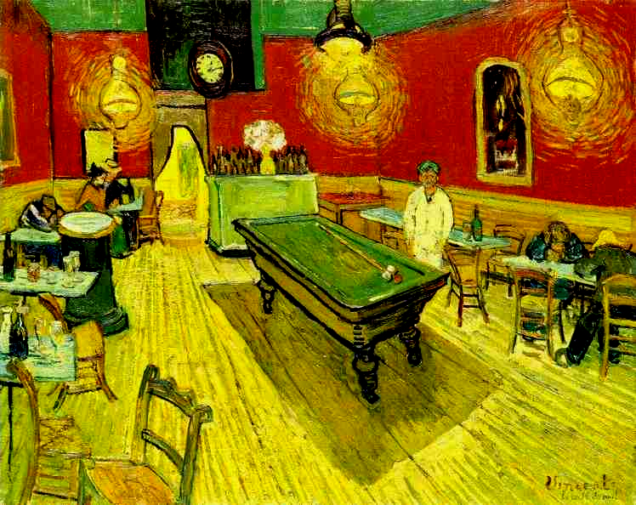
Click on image for Video
Vincent van Gogh, The Night Cafe, 1889

Slide 62
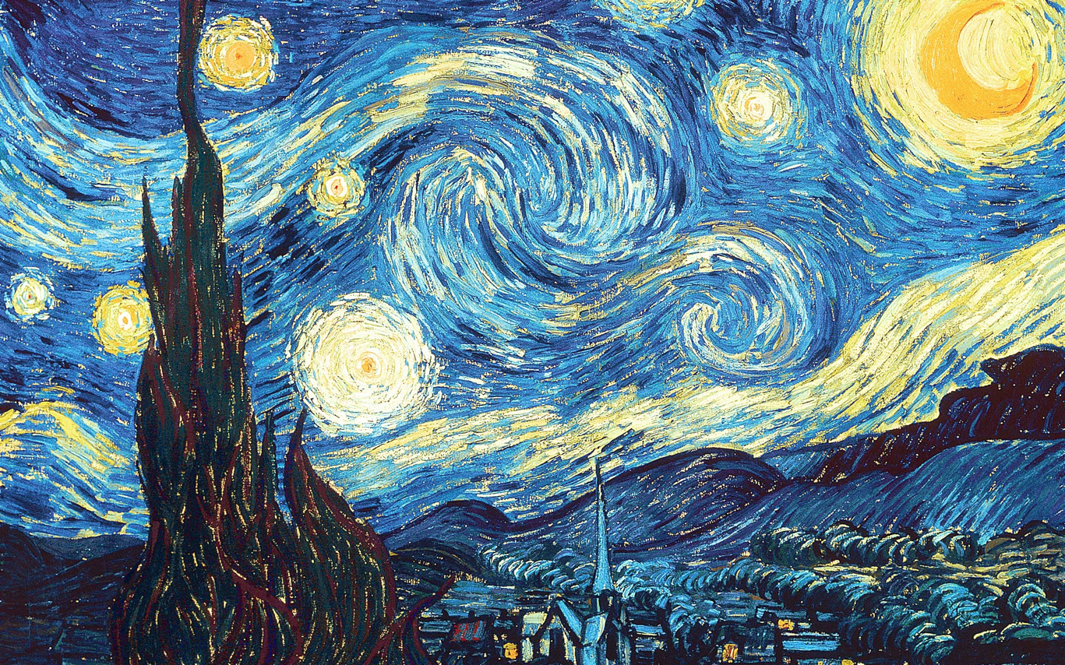
Vincent van Gogh, Starry Night, 1889

Slide 63
Expressionistic Art

Slide 64
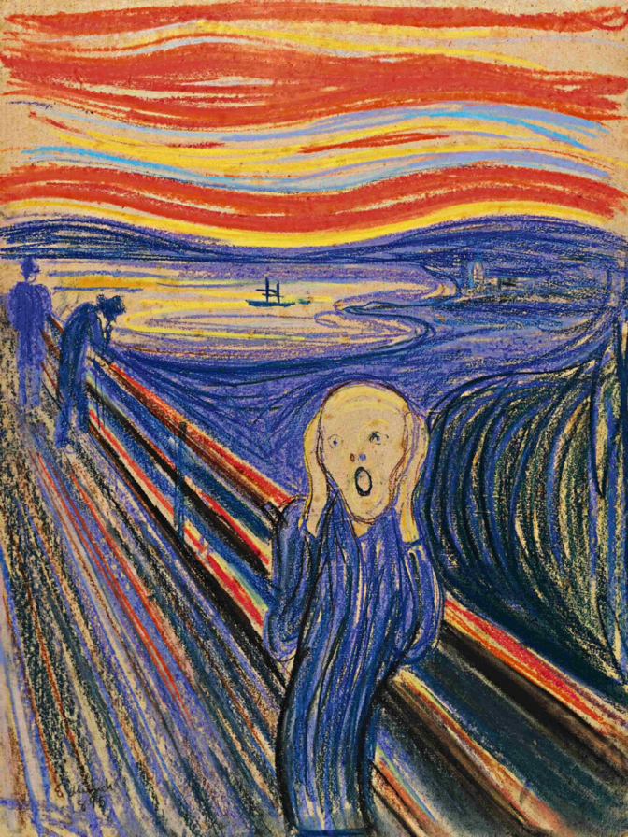
Click on image for Video
Edvard Munch, The Scream, Norway 1893

Slide 65
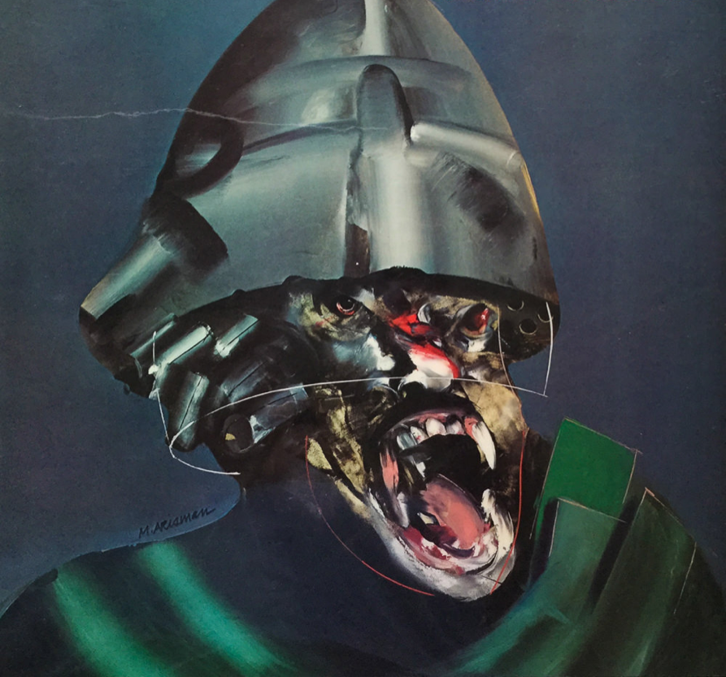
Click on image for Video
Marshal Arisman, Revenge of Permanent Wave, USA 1995

Slide 66
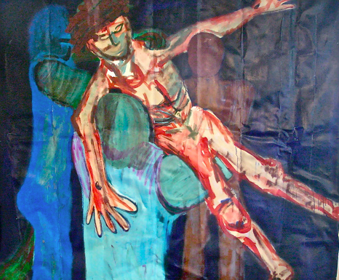
Kevin Casto, Lowering Jesus from the Cross, 1995, Acrylic on canvas
Kevin Casto, Lowering Jesus from the Cross, USA 1995
acrylics on canvas

Slide 67
Semi-abstract Art

Slide 68
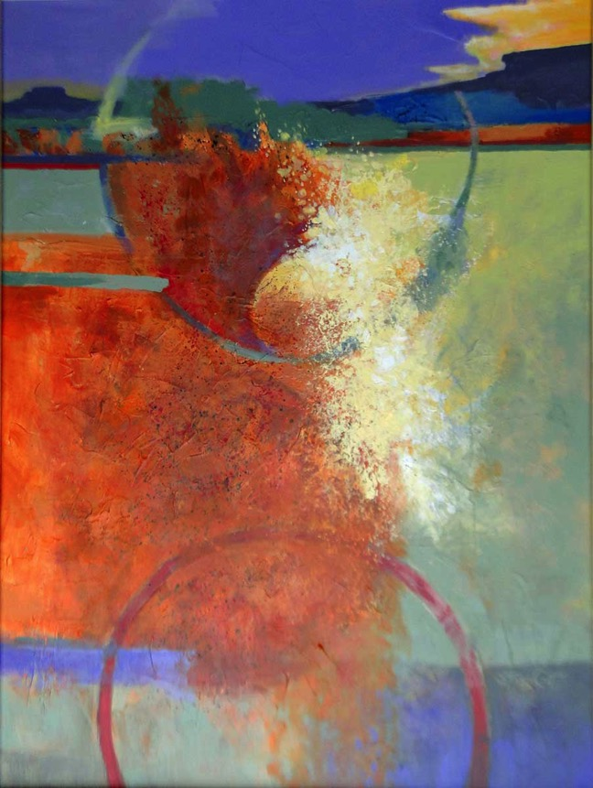
Steven Cost, Don Carlos, acrylics on canvas 2017

Slide 69
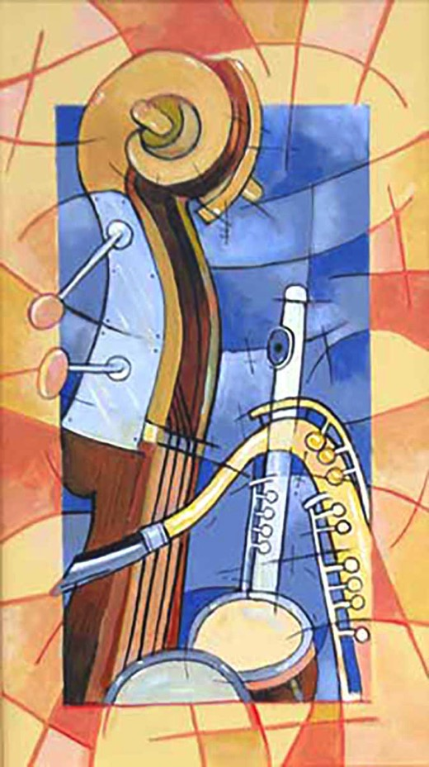
Steven Cost, Jazz Quartet, acrylics on canvas 2015

Slide 70
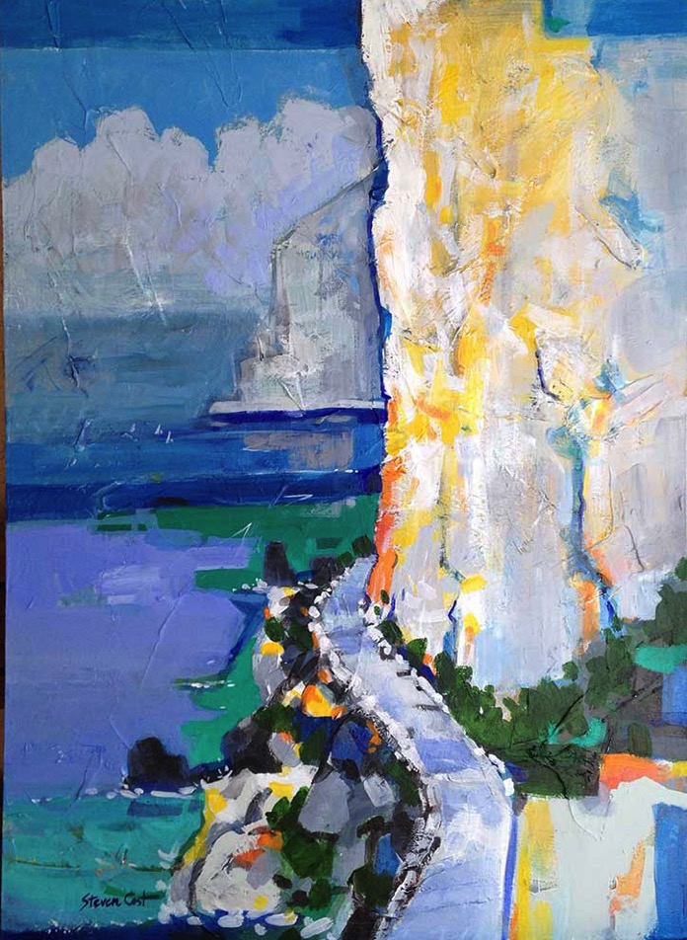
Steven Cost, Capri Cliffs, acrylics on canvas 2015

Slide 71
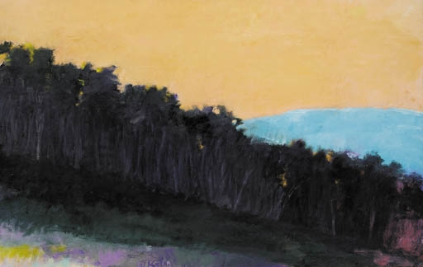
Wolf Kahn, Afterglow 1, 1974

Slide 72
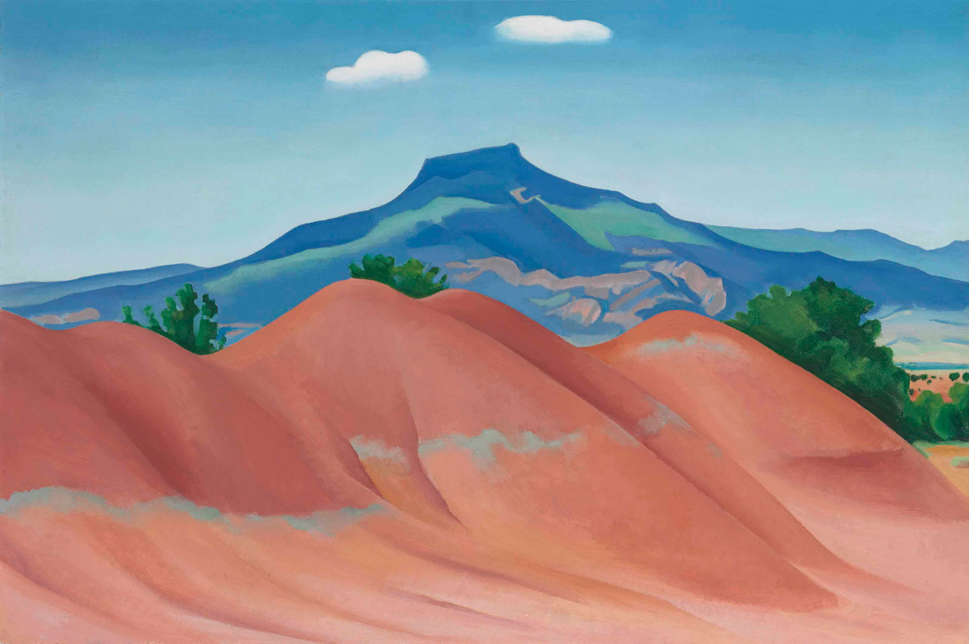
Click on image for Video
Georgia O’Keeffe, Pendernal, oil on canvas 1936

Slide 73
Abstract Art

Slide 74
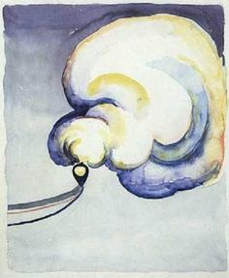
Click on image for Video
Georgia O’Keeffe Train at Night in the Desert,
Canyon, Texas 1916

Slide 75
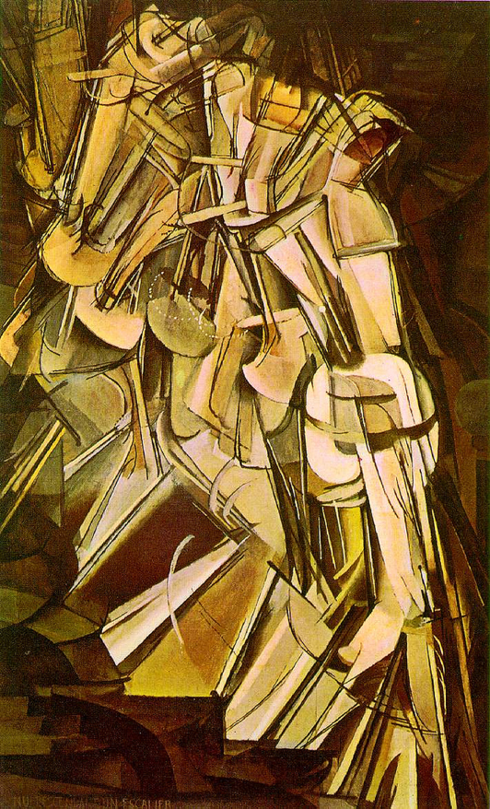
Click on image for video
Click on image for Video
Marcel Duchamp, Nude Descending a Staircase 1912

Slide 76
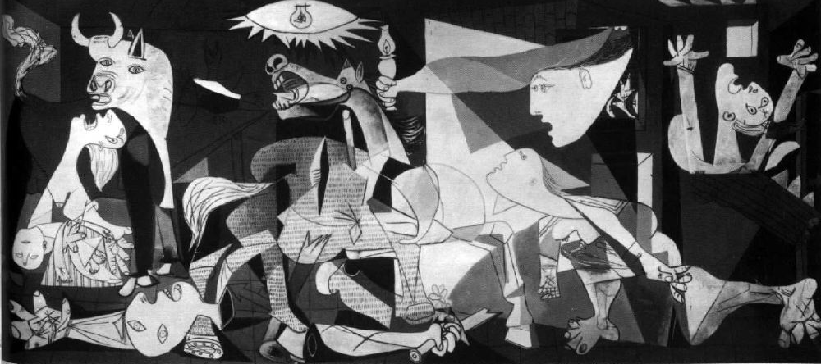
Click on image for video
Pablo Picasso, Guernica, Spain 1937

Slide 77
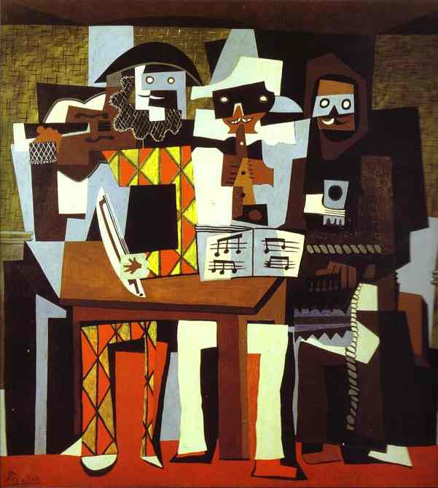
Pablo Picasso, Three Musicians, Spain 1921

Slide 78
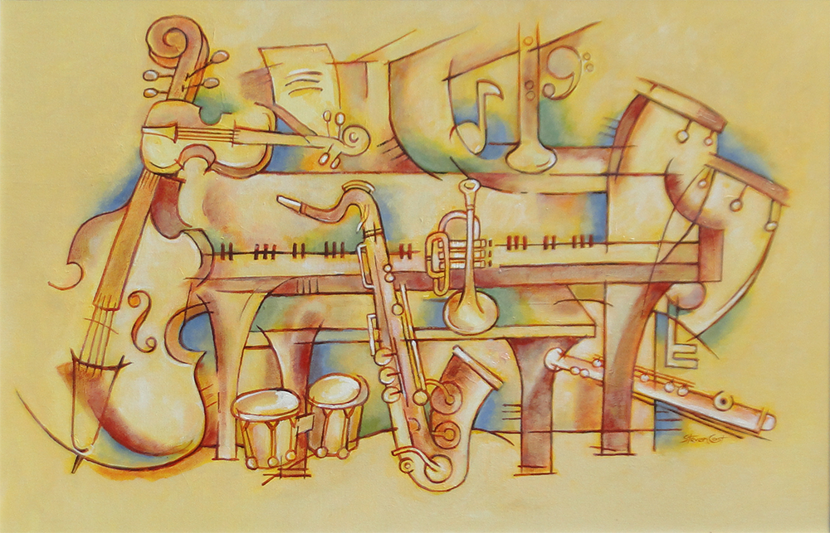
Ensemble by Steven Cost, acrylics, 36” x 24”

Slide 79
Non-objective Abstract Art

Slide 80
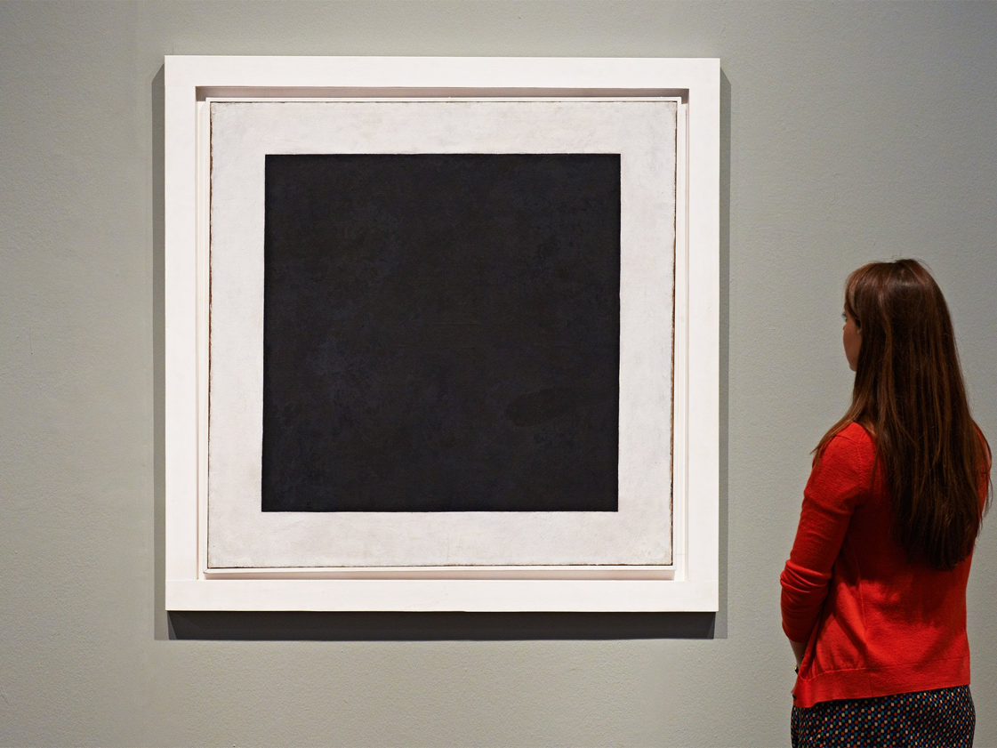
Click on image for Video
Click on image for video
Kazimir Malevich, Black Square, Russia 1919

Slide 81
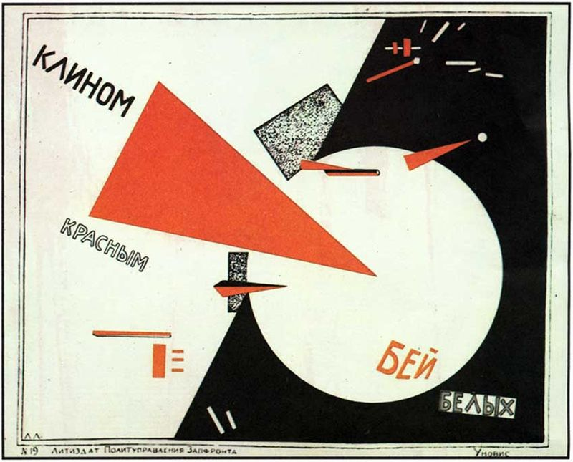
Click on image for video
Lithographic propaganda poster by Lazar Lissitzki, Beat the Whites with the Red Wedge, Russia 1919

Slide 82
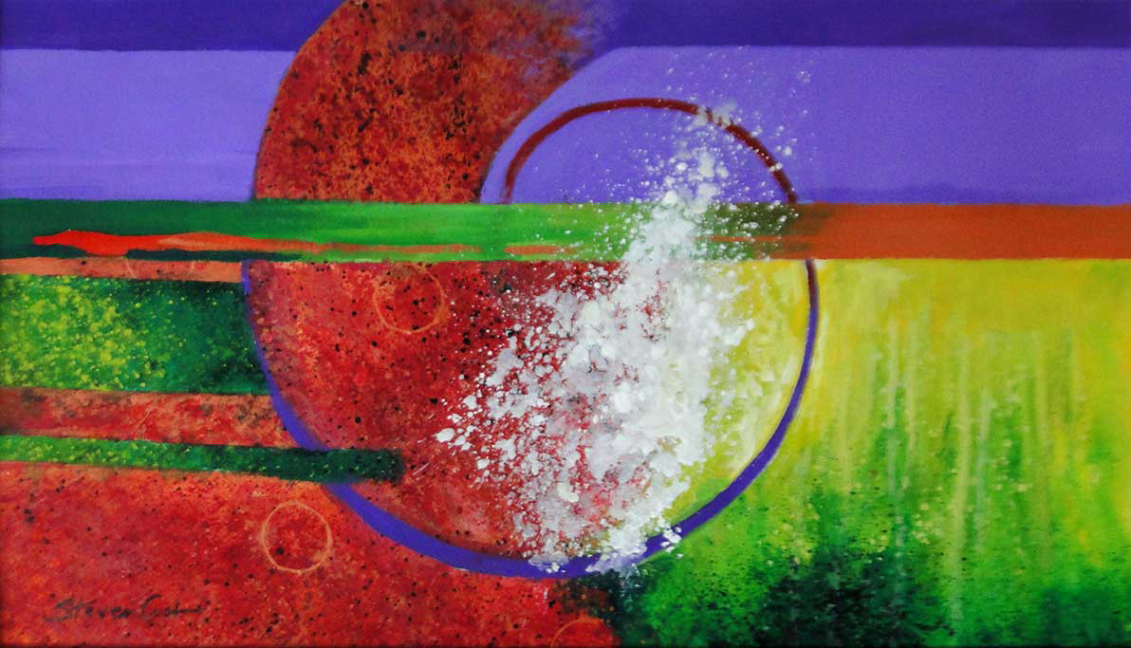
Steven Cost, The Source of Everything, acrylics on paper 2017

Slide 83
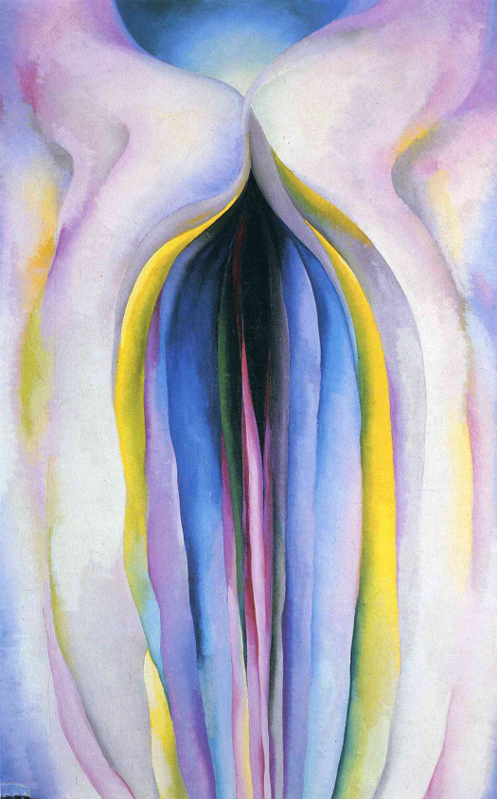
Georgia O’Keeffe, Gray Line with Black, Blue and Yellow, oil on canvas 1923

Slide 84
Through his entire career, from his portrayal of a brothel in his 1907 Les Demoiselles d’Avignon, Pablo Picasso represented his relation to women as a sort of battlefield between attraction and repulsion.

Slide 85
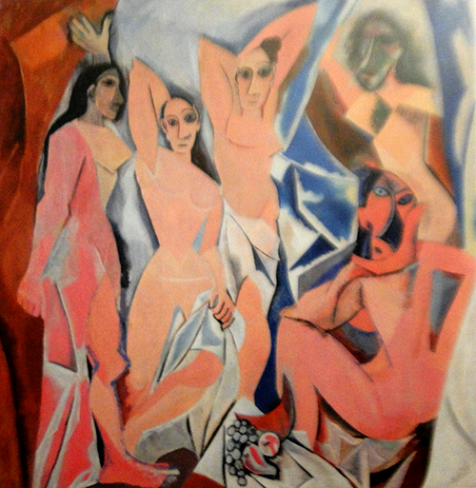
Pablo Picasso, Les Demoiselles d’Avignon 1907 .

Slide 86
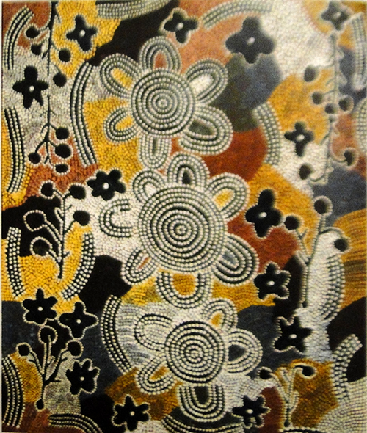
Mick Tjakamarra, Honey Art Dreaming, 1982

Slide 87
A young art teacher named Geoff Bardon arrived in Austrailia in 1971. Austrailian Aboriginal men became interested in Bardon’s classes. Between 1977 and 1979, they moved from small works to large-scale canvases. On of them, Old Mick Tjakamarra, made a painting Honey Art Dreaming, that depicts the landscape of Papunya Tula, Austrailia..

Slide 88
Is art of so-called higher civilizations better than art of more primative cultures?

Slide 89
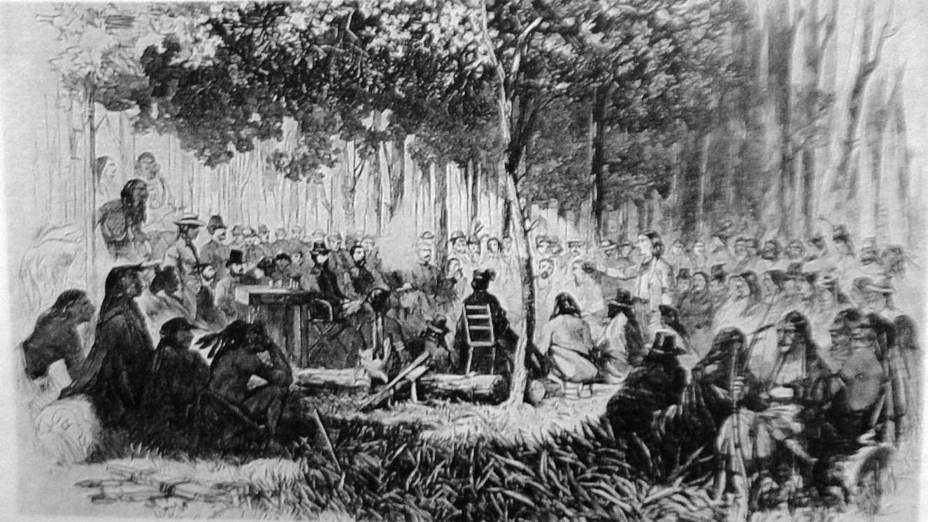
John Taylor, Treaty Signing at Medicine Lodge Creek,
engraving 1867

Slide 90
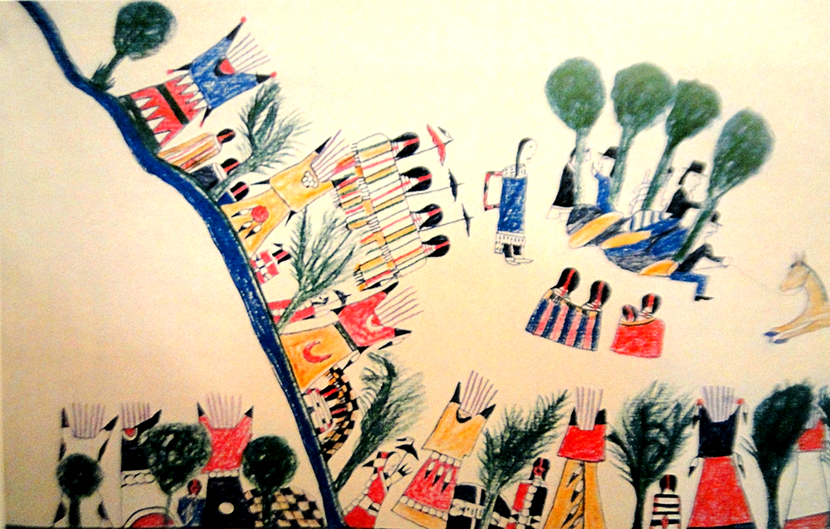
Click on image for video
Howling Wolf, Treaty Signing at Medicine Lodge Creek,
ledger book painting 1878

Slide 91
How does art reflect on a society?

Slide 92
How does one determine if a work of art is good?

Slide 93
Is art limited to painting, drawing, and sculpture? What other art forms are there?

Slide 94
Installations Large works of art that invites the viewer to enter and move around it or inside it, to be seen from various view points, and participate and interact with it

Slide 95
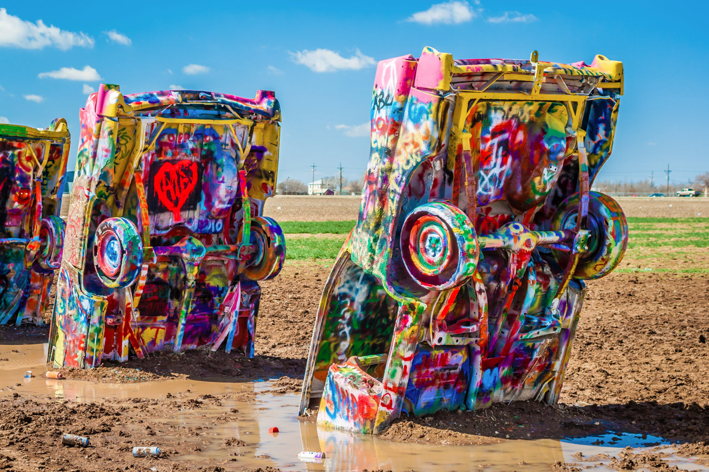
Click on image for video
Ant Farm, Cadillac Ranch, Amarillo, Texas 1974
Installation commissioned by Stanley Marsh 3

Slide 96
Ligntnin’ McDuff, Ozymandias, Amarillo 1997 steel and concrete, Installation commissioned by Stanley Marsh 3

Slide 97
Click on image for video
Installation Art

Slide 98
Ephemeral Art Art that is made of substances that are temporary in nature such as a performance, ice, stacked stones, light show and fireworks.

Slide 99
Click on image for video
Ephemeral Art — Installation Light Show

Slide 100
Richard Shilling, stone construction Balance

Slide 101
Emphemeral art in Colorado Springs

Slide 102
Ice scultures

Slide 103
Fish sculpters made of discarded plastic bottle, botofogo Beach, Rio de Janeiro, Brazil

Slide 104
Click on image for video
Burning Man, Iron Rock, Nevada

Slide 105
Click on image for video
Pink Floyd Concert Light Show

Slide 106
Click on image for video
Defqon.1 Weekend Festival 2018

Slide 107
Click on image for video
ER Productions at LDI 2017

Slide 108
Click on image for video
10 Best Fireworks of 2019

Slide 109
Earth Works Art that made from the earth or using the earth as a major proponent.

Slide 110
obert Smithson, Spiral Jetty, 1970
Click on image for video
Robert Smithson, Spiral Jetty, California 1970

Slide 111
obert Smithson, Spiral Jetty, 1970
Click on image for video
Robert Smithson, Amarillo Ramp, Amarillo, Texas 1973

Slide 112
obert Smithson, Spiral Jetty, 1970
Commissioned by Stanley Marsh 3, Floating Measa,
Amarillo, Texas 1981
Click on image for video

Slide 113
The Lightning Field (1977)
Artist: Walter de Maria
obert Smithson, Spiral Jetty, 1970
Walter de MariaThe Lightning Field,
New Mexico 1977

Slide 114
Cultural Interpretations

Slide 115
At the terminus of the Silk Road, since the time of the Han Dynasty (206 bce–220 currect era), Dunhuang was the place where the cultures of the East and West first intersected.

Slide 116
Silk Road Map. Reclining Buddha, Mogao Caves, Dunhuang, China

Slide 117
Click on image for video
Jan van Eyek, The Ghent Altarpiece, 1432, 15’ x 11 ‘

Slide 118
Click on image for video
Jan van Eyek, Giovanni and His Wife, 1434

Slide 119
Click on image for video
Michelangelo Buonarroti, Sistine Chapel detail

Slide 120
Click on image for video
Isamic patterns and calligraphy

Slide 121
Click on image for video
Old Mick Tjakamrra, Honey Art Dreaming, Australia 1982

Slide 122
Click on image for video
Africa Dancing Mask, Lake Tanganyika

Slide 123
Click on image for video
Prehistoric cave art

Slide 124
Click on image for more information
Archie Blackowl, Southern Cheyenne, Peyote Ceremony, Oklahoma 1962 collection of Steven Cost

Slide 125
Howard Terpning, Leader of Menby, oil 1977

Slide 126
Click on image for video
T. C. Cannon, Gracemont, Okla., Mother Gestating Me While Walking Along the Washita River, 1968

Slide 127
La Calavera Catrina (‘The Elegant Skull) by Mexican artist and printmaker José Guadalupe Posada, 1852-1913. The woman is often accompanied by a man in a top hat or a Mexican Revolutionary man.
Click on image for video

Slide 128
REVIEW Just as dark descended on New York City at 5 pm each night between January 16 and February 12, 2007, five 12-minute 57-second films were played on a loop for five hours, until 10 pm, in different combinations across eight different external walls of the Museum of Modern Art. What is the title of this art installation?

Slide 129
REVIEW What medium did Cai Guo-Qiang use to create Footprints of History, that was used for the opening ceremony of the 2008 Beijing Olympic Games?

Slide 130
REVIEW Physically, visual processing can be divided into three steps. They are: reception —> extraction —> inference

Slide 131
REVIEW All people are or can be creative, but not all people possess the energy, ingenuity, and courage of conviction that are required to make art.

Slide 132
REVIEW While differing from culture to culture and from time to time, the term, “aesthetic,” refers to our sense of the beautiful.

Slide 133
REVIEW Generally, we refer to works of art as either representational or abstract.

Slide 134
REVIEW Old Mick Tjakamarra, made a painting that depicts the landscape of Papunya Tula, Austrailia. What is the title of the painting?

Slide 135
REVIEW What art term is used to define what a work of art expresses or means (or suggests to the viewer’s imagination)?

Slide 136
REVIEW What is the term used when cultural conventions are often carried forward from one generation to the next by means of a system of visual images the meaning of which is widely understood by a given culture?

Slide 137
REVIEW What do we call art that is so realistic that it creates an illusion that “fools the eye”?

Slide 138
REVIEW What do we call art and artists who are considered historically ahead of their time?

